Slide 1
SART Updates: Dairy Hurricane Preparedness
Summer Williams & Kevin See Division of Food Safety

Slide 2
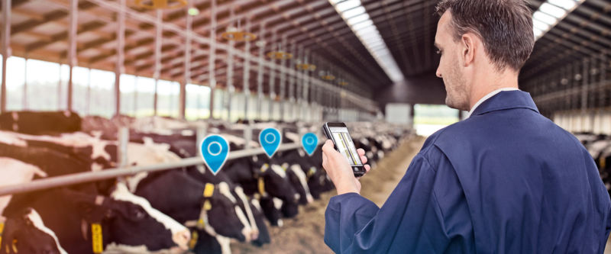
GIS- Maps, Maps, and More Maps!
Utilizing GIS for:
Resource Planning- personnel and facilities
Emergency Response Assessments- Survey 123
Possibility of more ideas

Slide 3
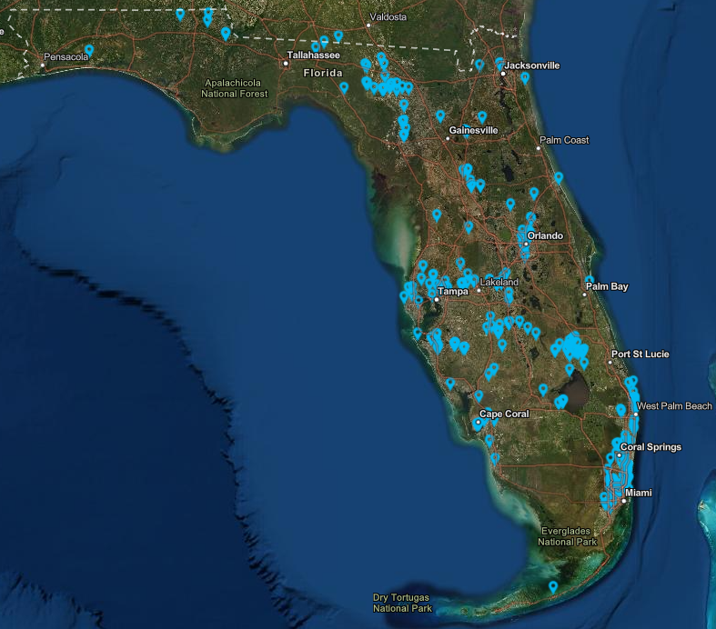
Automatic Data – moving to FIMS

Slide 4
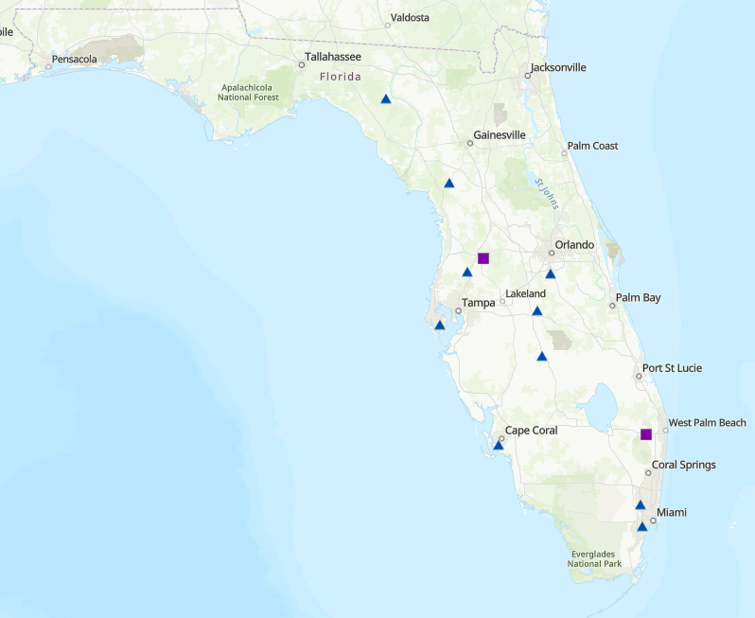
Inspector Locations

Slide 5
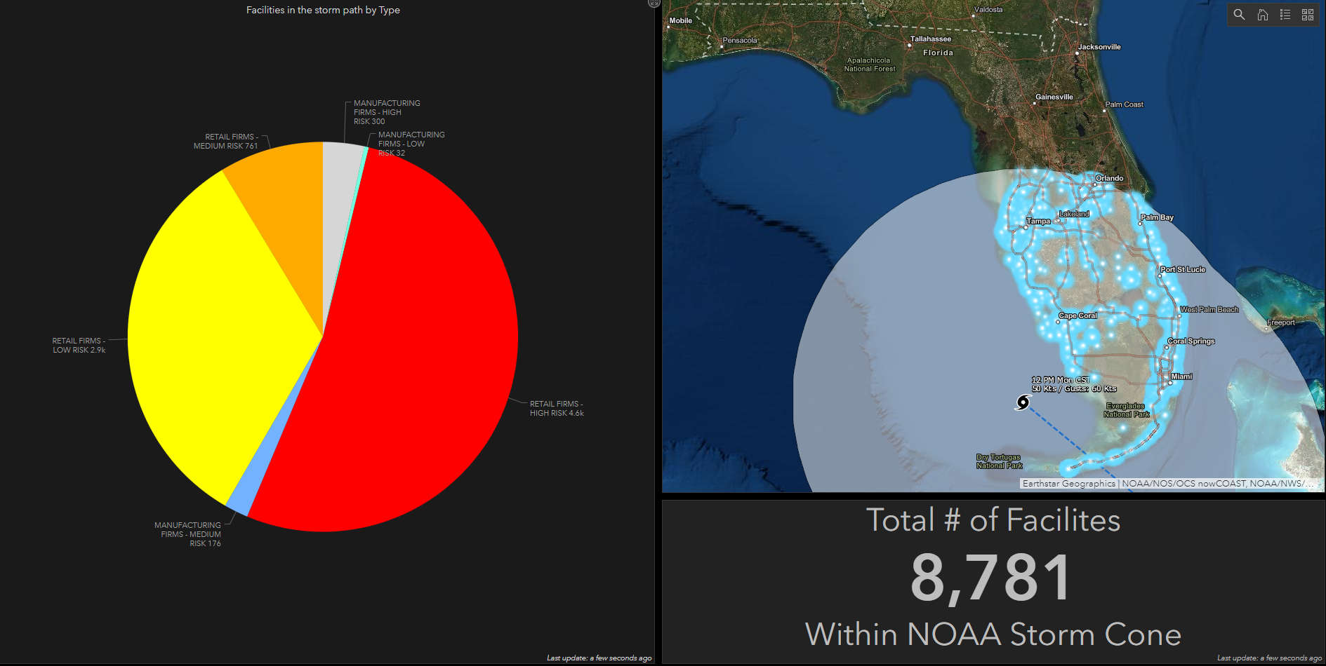
TS Eta Response Planning

Slide 6
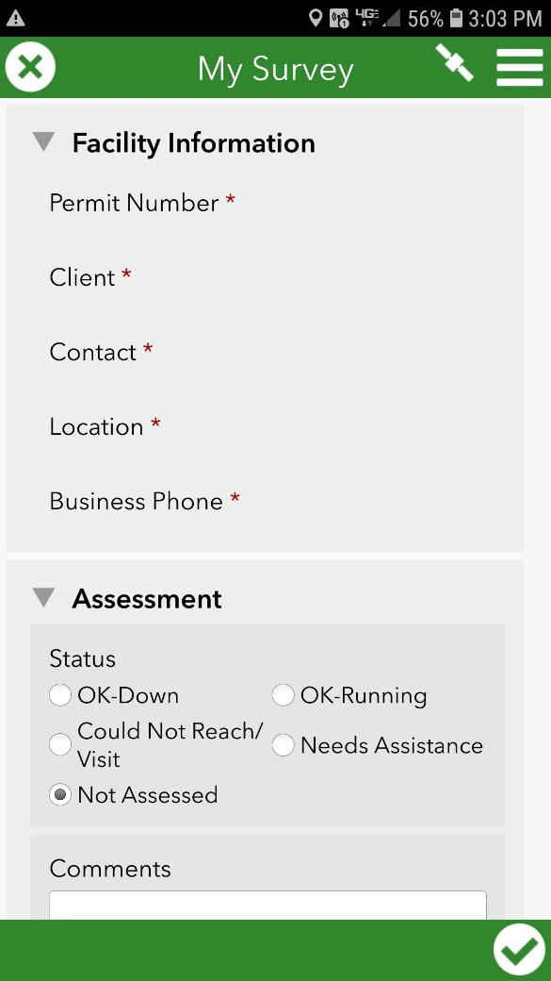
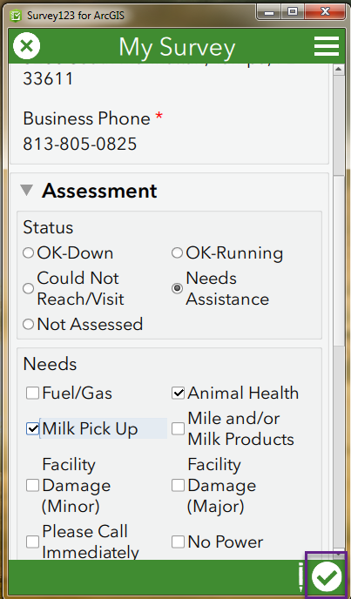
Survey 123 for Damage Assessments
Tracks in Real Time from inspector in field directly to dashboard
Data for situational awareness
Provides a better operational picture

Slide 7
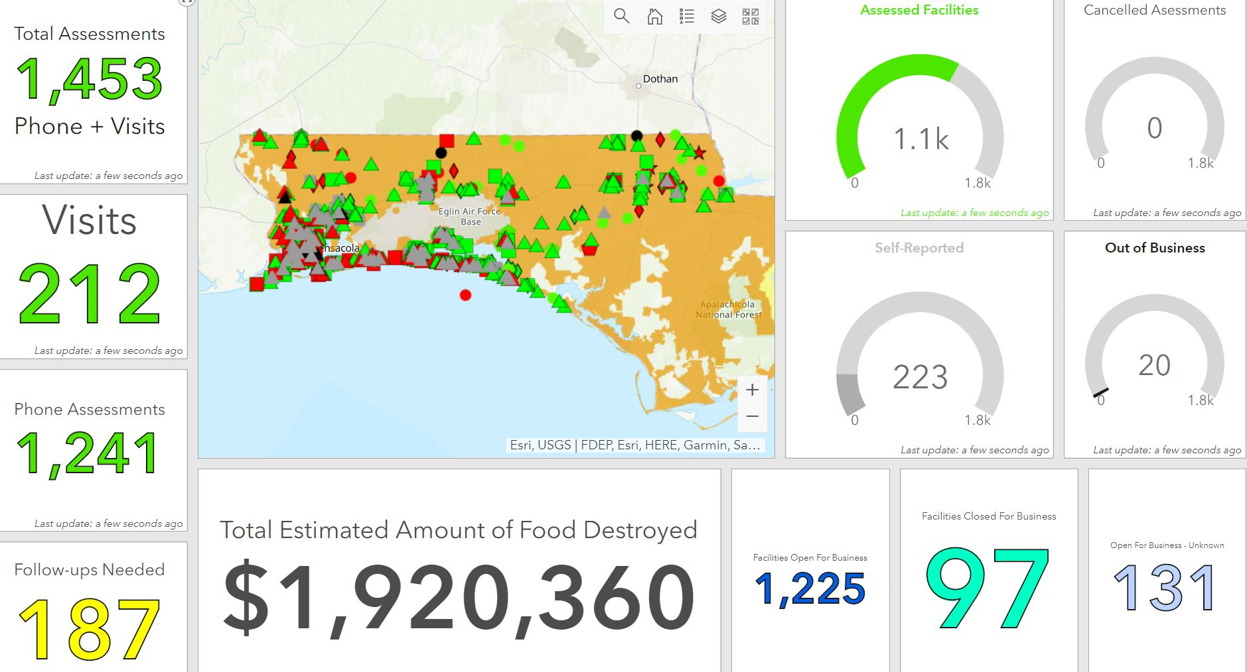
Hurricane Sally Response Dashboard

Slide 8
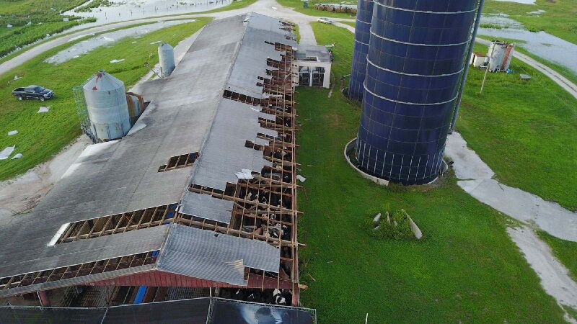
Industry Preparedness
Emphasis on having an Emergency Action Plan for all dairy establishments, hauling companies, and cooperatives to ensure minimizing foodborne illness and a continuity of operations following a power outage or other damage from a storm
Dairy Emergency Information Sheets
Preparedness Questionnaire Flyer

Slide 9
Before the Storm
Inspectors make contact with all facilities in their territories to assess potential public health risks to dairy supply.
Facilities are encouraged to make necessary preparations to protect against structural damage (IE milk storage, silos, parlors, barns, etc).
Possible contingency plans to ensure continued production of dairy products are discussed.
Facility addresses and contact information are updated.

Slide 10
After the Storm
As soon as it is safe to do so, inspectors immediately begin making contact with facilities and taking note of damages, power outages, possible public health risks, interruptions to production, etc.
Inspectors make use of Survey123 app to keep track of contacted facilities and their status.
The Bureau of Dairy Industry is typically able to contact, assess, and report on all dairy facilities statewide within a few hours after an event.

Slide 11
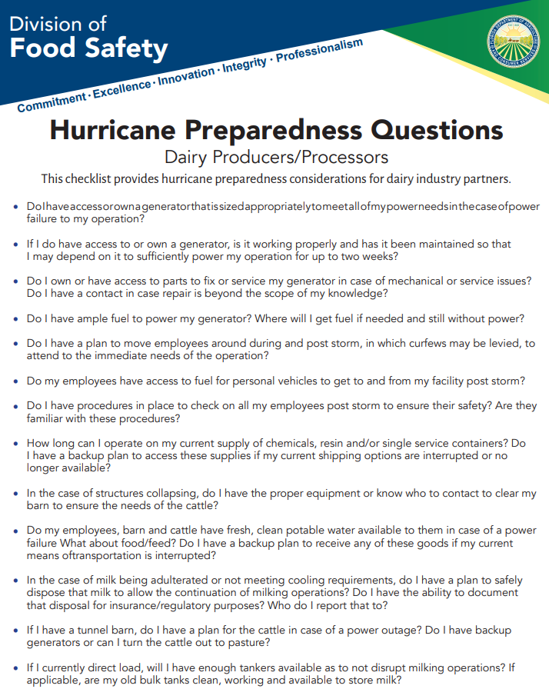

Slide 12
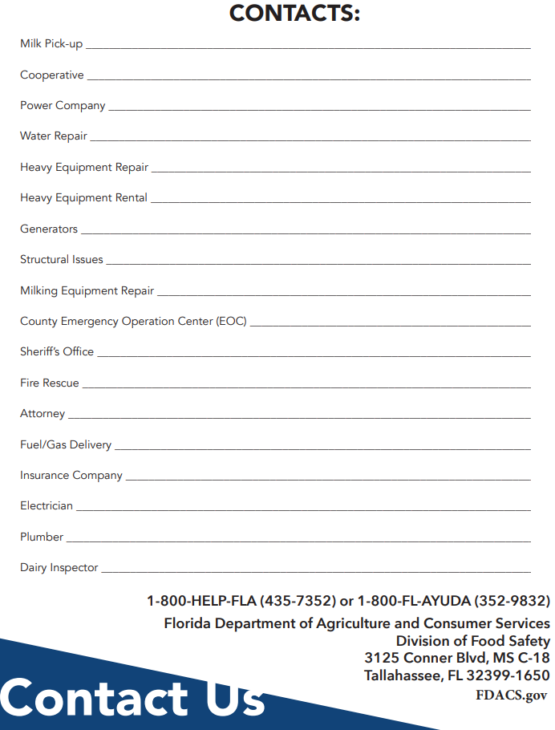

Slide 13
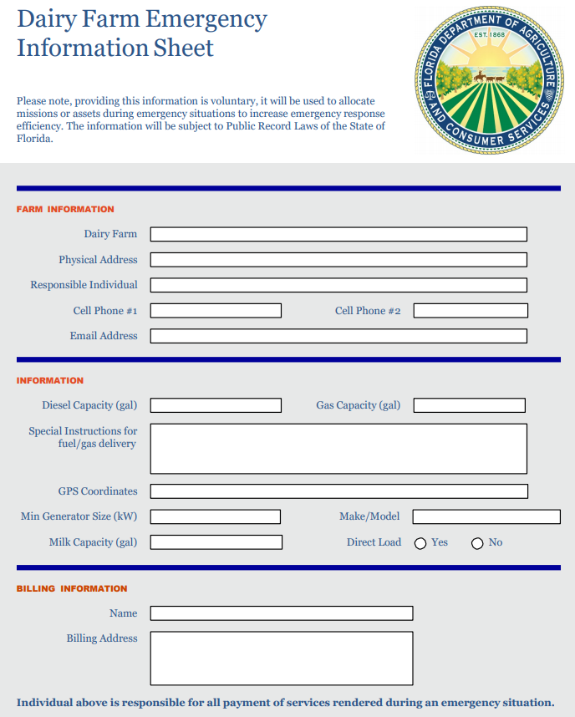

Slide 14
Contact
Kevin See Environmental Specialist III
State Rating Officer
(850) 815-2197
Kevin.See@FDACS.gov
Summer Williams
Emergency Response Coordinator
(850) 245-5535 Office
(850) 251-5115 Cell (no texting capabilities)
Summer.Williams@FDACS.gov

